Slide 1
Team Meetings Week 1
Made a teams group chat and a snapchat group chat.
Made a GitHub repository.
Brainstormed ideas for the project.
Ideas include…
Crypto Management app
Memory loss system for smart glasses
A (maybe cross app) game
Calorie tracker
Calendar app

Slide 2
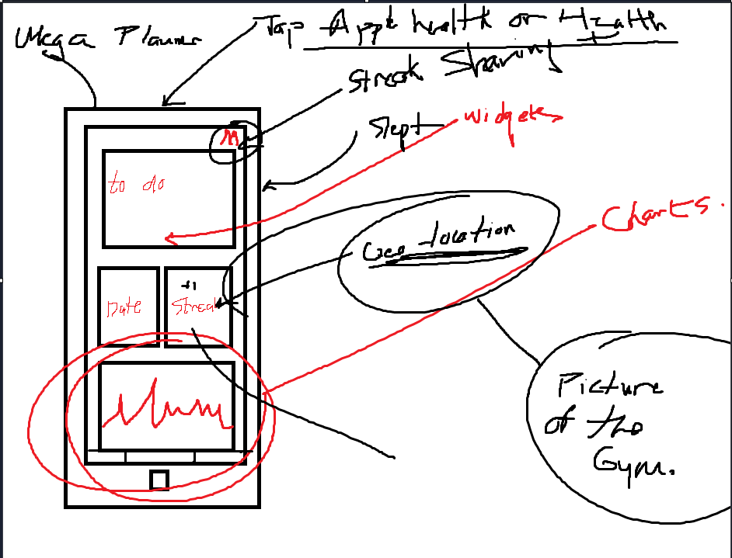
Team meetings week 2
Settled on a planner app where you set up a to-do list that tracks your activities throughout as well as customisable widgets based on the user interests.
These widgets can include but aren’t limited to Calorie intake, crypto price charts, gym activities, health statistics and more.
Created a mock up of the app Ui.
We could use MongoDB, Angular and Python.
Ready to start week 3.

Slide 3
Our app idea - Laoi Rafferty
A social productivity app
Users can track their habits with a streak system
Users can add friends and share streaks or view progress for themselves, friends or groups
Will implement a widget-like system that allows for customisation

Slide 4
Our week in review:
Made a mock up of project – an initial view of how we hope the project will look
Communicated on snapchat about scheduling
Held meeting to discuss our ideas (study room + online call)
Spoke about the technology, languages and frameworks we plan to use: angular, mongodb, python

Slide 5
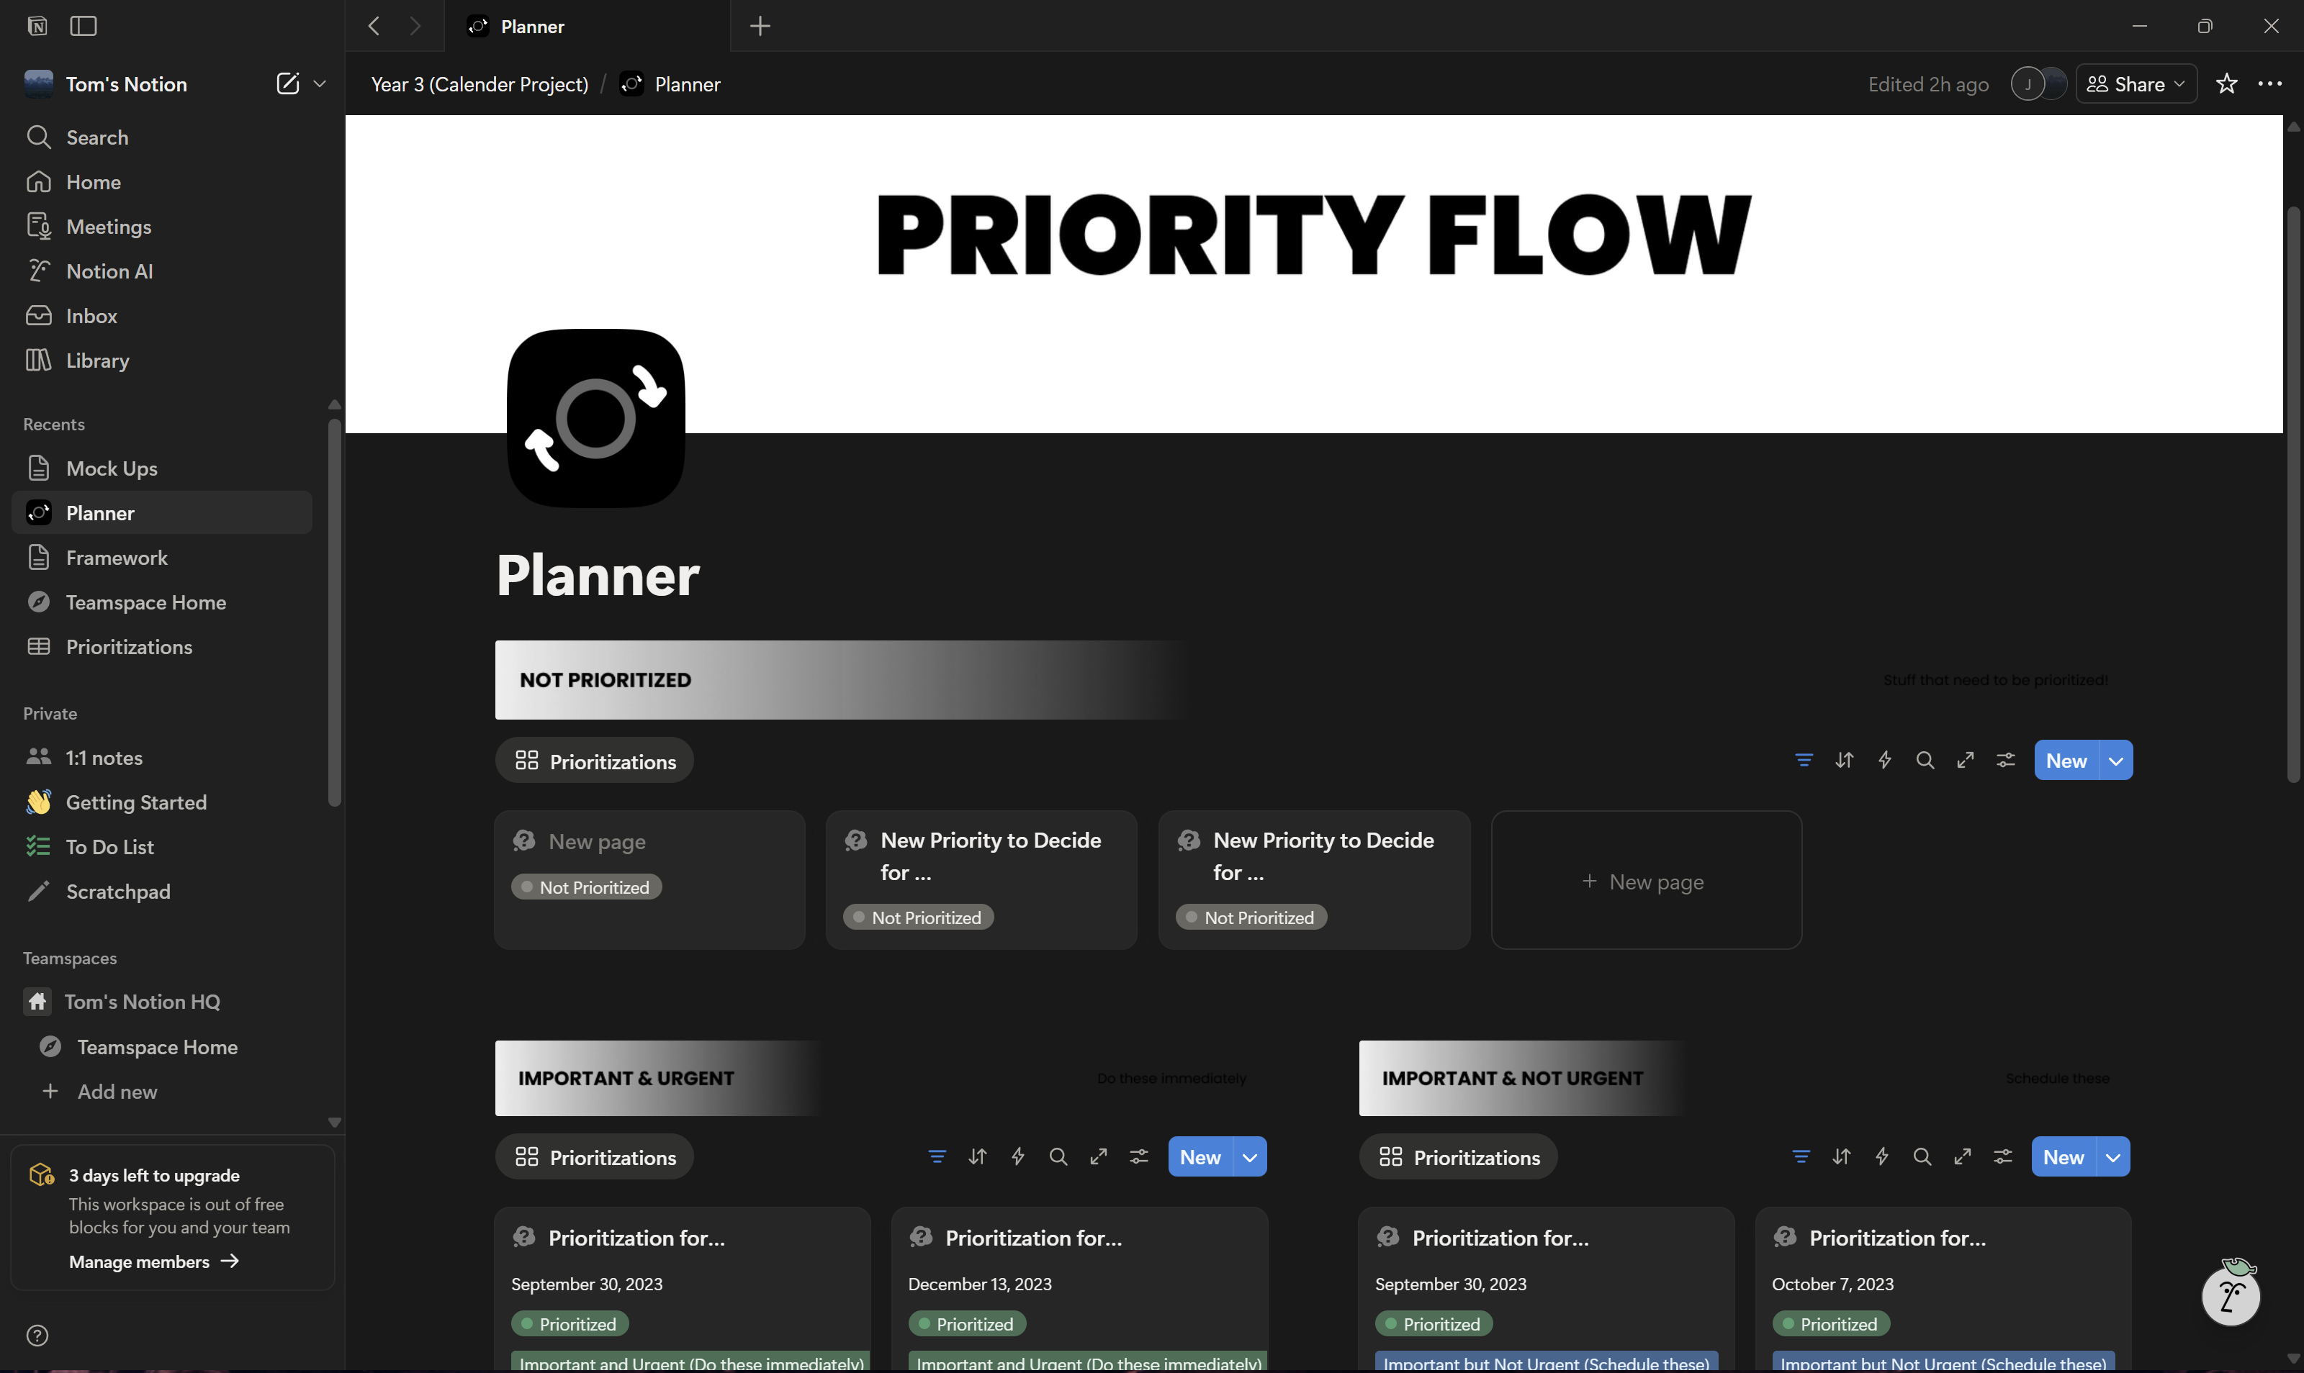
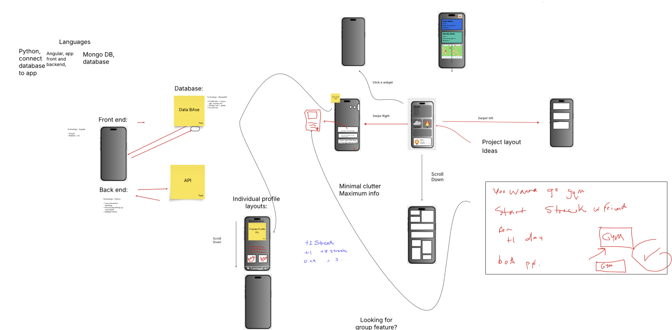
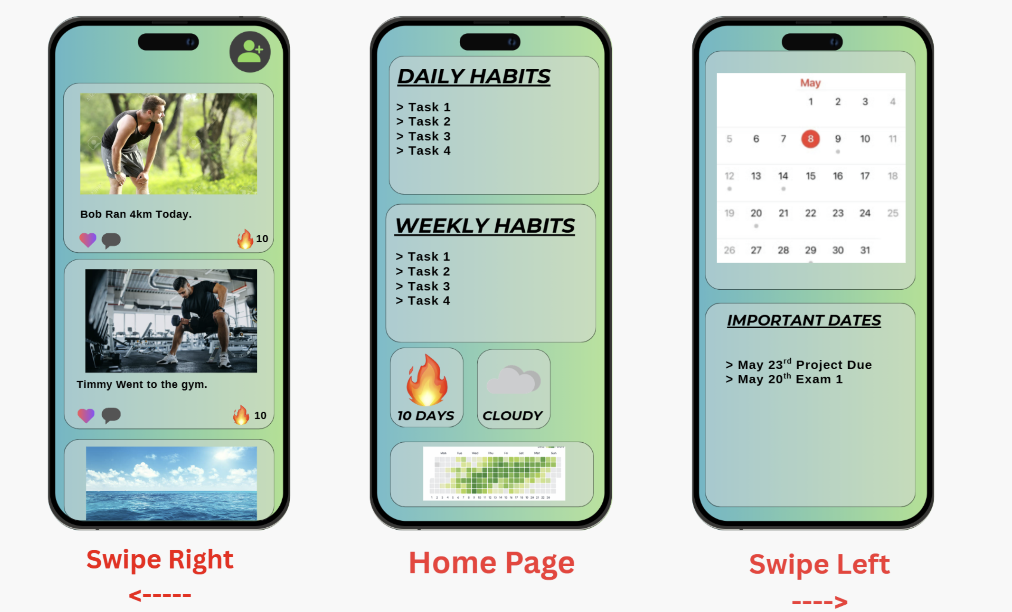
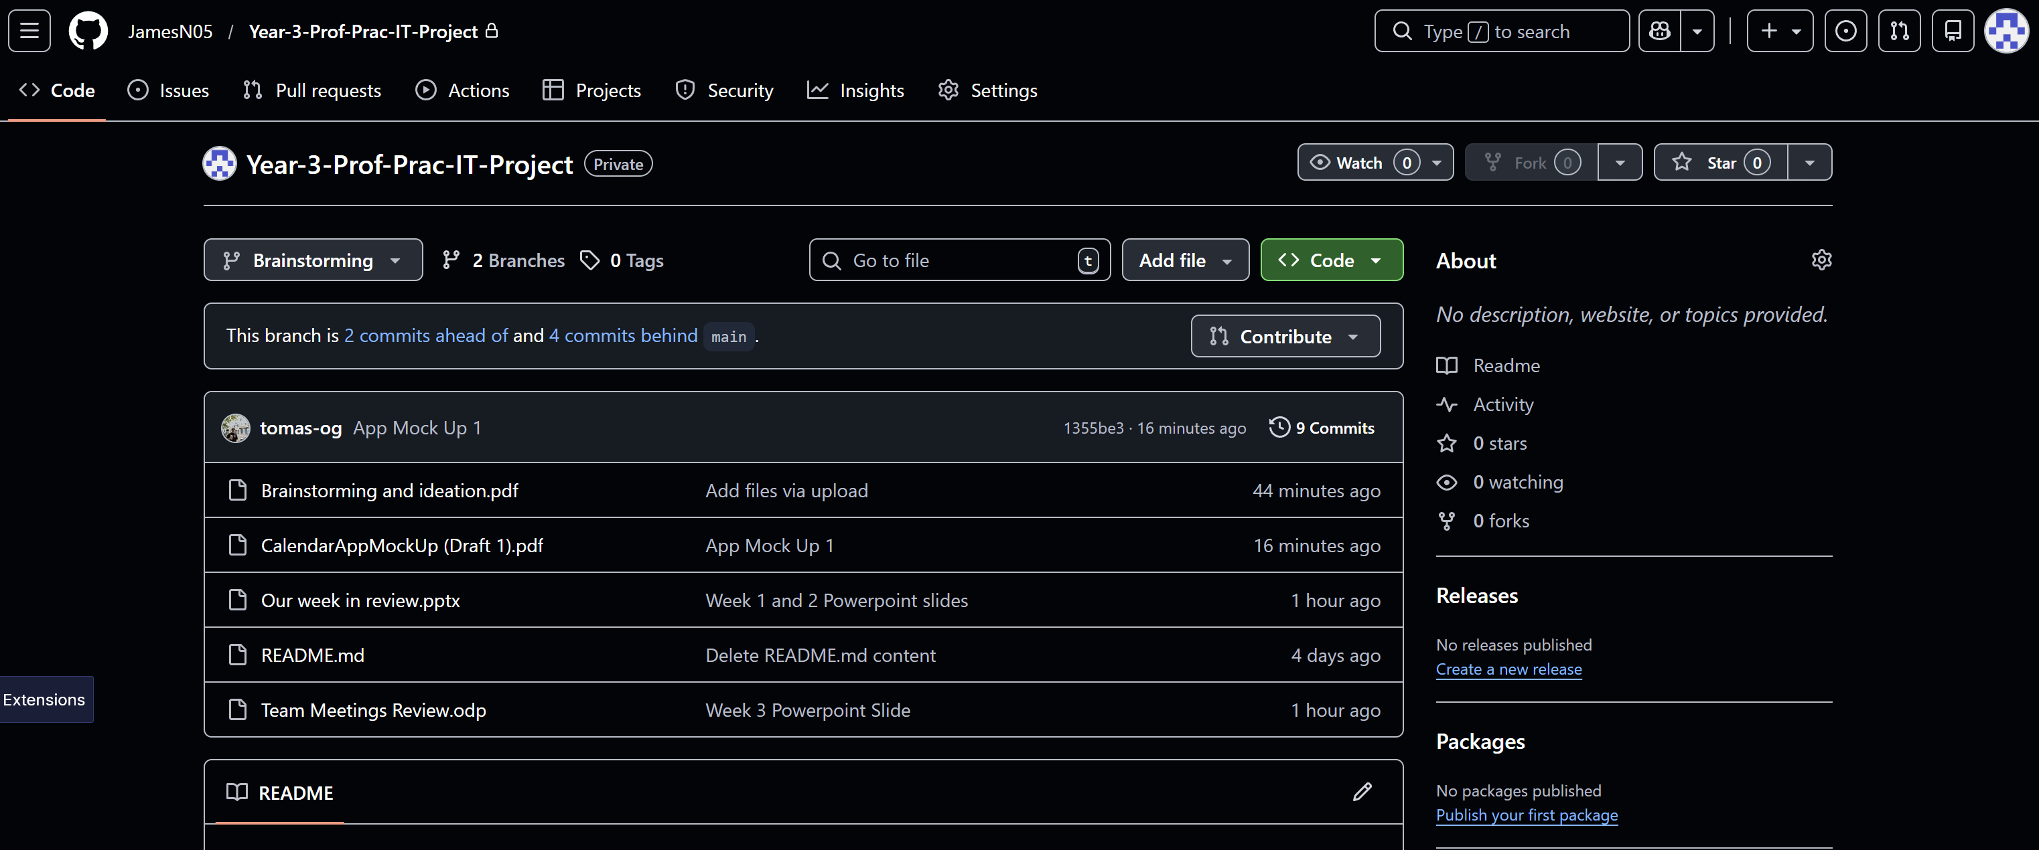
Team Meetings
Week 4
Updated GitHub with a branch specific to brainstorming, PowerPoint and app mock-ups.
Tom made an app mock up of the app interface from the user’s perspective.
We went on Lucid Spark and brainstormed the framework of the app and the functionality of how the user interacted with it.
We set up a Notion for us to plan, schedule and share notes on different parts of the project.
Framework: MongoDB – Database, Python – Backend, Angular – Frontend, user info saved in database, cross platform application.

